Slide 1
Classifying Toxic Comments
Using machine learning to find the bad ones
A Data Science Capstone Project by Dovid burns

Slide 2
Main Problem and Client
Toxic comments posted in public forums online are common, and they are so corrosive that they rapidly shut down otherwise engaging discussions
Many Platforms, e.g. Facebook, YouTube, Twitter, Wikipedia, Yelp and Instagram
Conversation AI team have models already but these make too many errors

Slide 3
Proposed Solution
Build a classifier using dataset of comments from Wikipedia’s talk page edits: classify comments as toxic or benign
The model can be used in many platforms for automatic detection—and removal—of toxic comments
Model can be used to track toxic behavior through time across multiple platforms to flag chronically problematic users

Slide 4
Awesome Dataset
159,571 comments taken from Wikipedia talk pages
15,294 were manually tagged as toxic by human graders

Slide 5
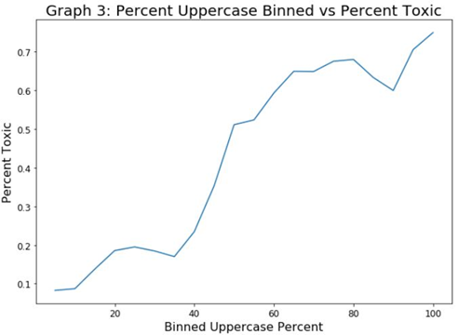
Binning: Log-Length + Percent Uppercase
Binned starting at 0-5%, increasing by 5% each time to see the trends in percent of toxic
Percent Uppercase Bins: X < 0.1, 0.1 <= X <0.45, 0.45<= X < 0.55, 0.55 <= X
Examined Length vs Percent Toxic and Log-Length vs percent toxic
Log-Length Bins: X<3, 3<=X<4, 4<=X<5, 5<=X<6, 6<=X<7, 7<=X<8, 8<=X

Slide 6
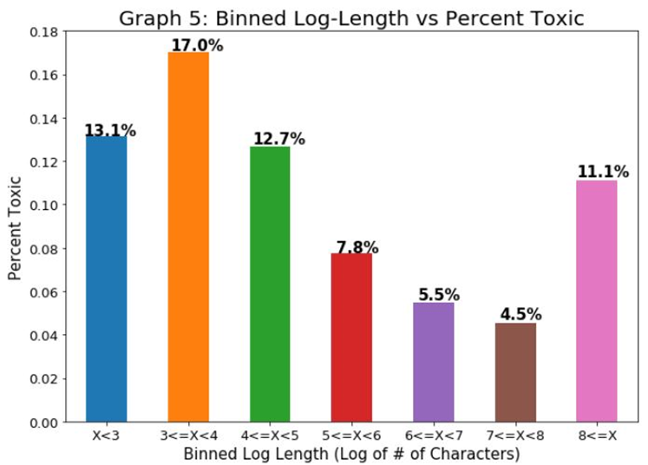
Binned Log-Length Variable
General trend is a negative correlation between Log-Length and Percent toxic
This is not true for the very short and very long comments
Chi-Squared test had p-value <0.001

Slide 7
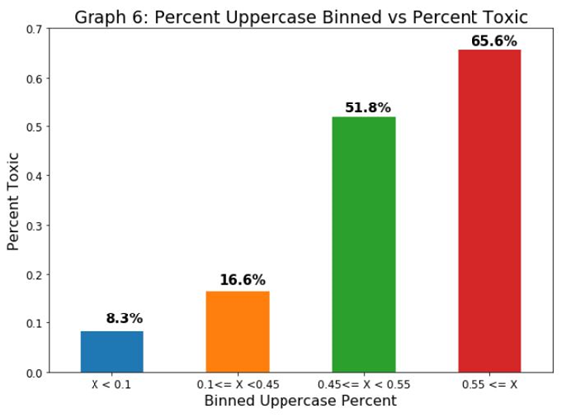
Percent Uppercase Variable
The more uppercase characters in a comment the more likely to be toxic
Makes sense – uppercase letters connote shouting
Chi-Squared test had p-value <0.001

Slide 8
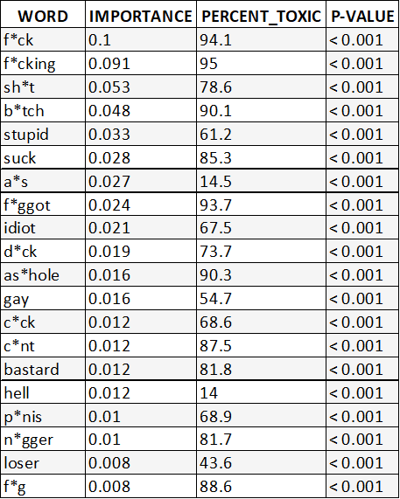
Most important Features From Random Forest
Created sub-groups of comments that contain these words
Analyzed them for percent toxic
Chi-Squared test showed statistical significance

Slide 9
Machine Learning Overview
Data Pre-Processing
Machine Learning Workflow
Clean text data and tokenize
Stem the words
Create dummy variables from the binned variables
Combine the two together
Split into test and train groups for machine learning evaluation
Use grid search to optimize hyperparameters
Create three models using, Naïve Bayes, Random Forest and AdaBoost
Find AUC scores and ROC curves for each model
Use a custom threshold to improve F1-Score
Find the best model based on AUC Score on test data

Slide 10
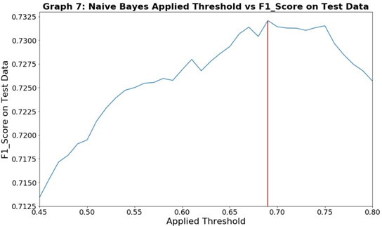
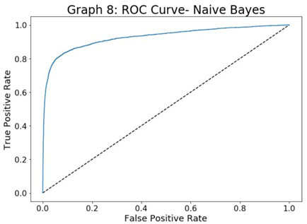
Multinomial Naïve Bayes
Optimized hyperparameters with grid search
CountVectorizer: min_df = 15, max_df = 0.2 and no max features
Alpha =1
AUC on Test Data = 0.928
F1-Score with threshold 0.732

Slide 11
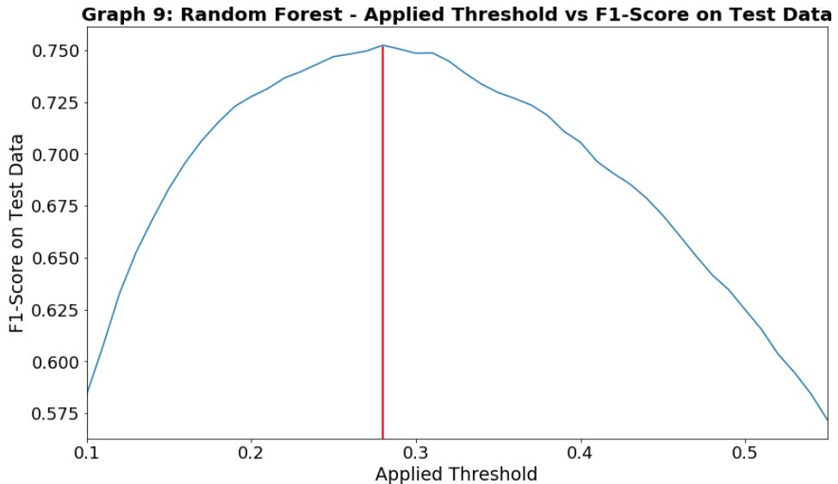
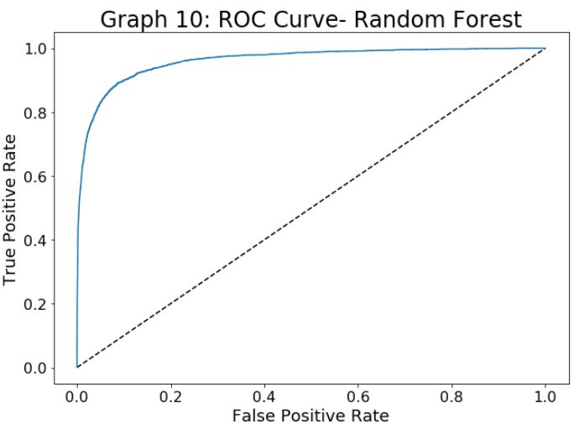
Random Forest
Optimized hyperparameters with grid search
CountVectorizer: min_df = 10, max_df = 0.2 and no max features
Random Forest: bootstrap= False, min_samples_leaf=10
AUC on test data = 0.961
F1-Score with threshold 0.752

Slide 12
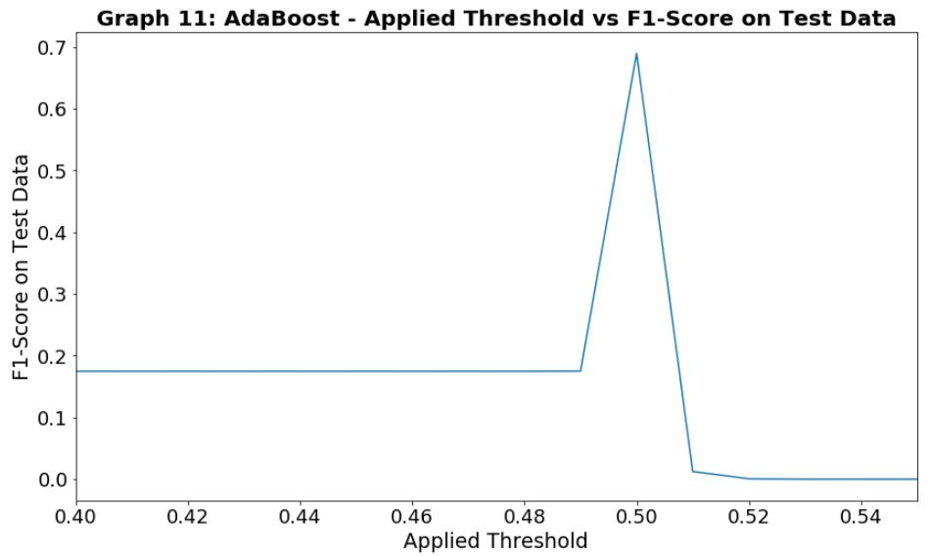
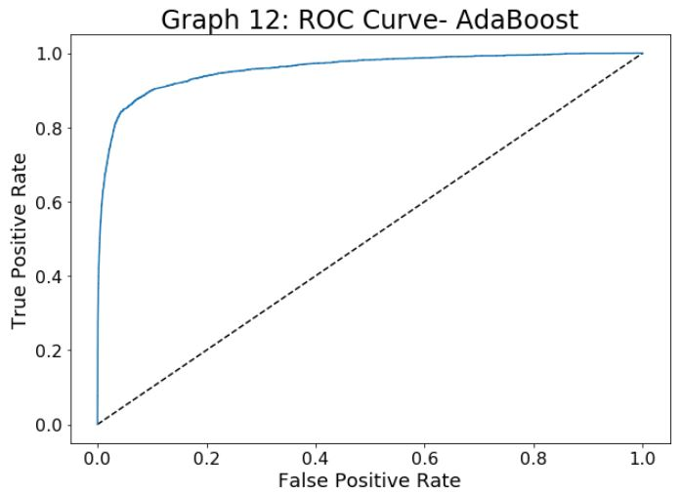
AdaBoost
Optimized hyperparameters with grid search
CountVectorizer: min_df = 0, max_df = 0.4 and max features = 10,000
AUC on test data = 0.957
F1-Score 0.69
Changing threshold did not increase F1-Score

Slide 13
Additional Data to Improve the Models
Broader comment base: Including YouTube, Facebook or Quora
Time elapsed from initial post to the comment response
Amount of time the user was part of the community
Past comment history, lots of toxic comment or few/ no toxic comments

Slide 14
Conclusion: Advice to Client
We successfully built a very strong Random Forest Classifier that can improve Conversation AI team’s current models
We recommend that public platforms implement a system of blocked or flagged words based on the Random Forest model’s top predictors
Score users retroactively using model to flag for extra monitoring or ban from making future comments based on individual history of posting toxic comments

